Slide 1
Events
SharePoint 2010 & 2013 Workflows

Slide 3
How to View This Presentation
To switch to Notes Page view:
On the ribbon, click the View tab, and then click Notes Page
To navigate through notes, use the Page Up and Page Down keys
Zoom in or zoom out, if required
In the Notes Page view, you can:
Read any supporting text—now or after the delivery
Add notes to your copy of the presentation, if required
Take the presentation files home with you

Slide 4
Overview
Workflow Manager
In this Lesson
Service Bus
Differences between workflows
Creating SharePoint 2013 Workflows using SharePoint Designer 2013
Creating SharePoint 2013 Workflows using Visual Studio 2013

Slide 5
Objectives
Learn what’s new with regard to SharePoint workflows
Get insight in the architecture supporting SharePoint 2013 workflows
Understand how to create workflows using SharePoint Designer
Learn how to use Visual Studio to build workflows

Slide 6
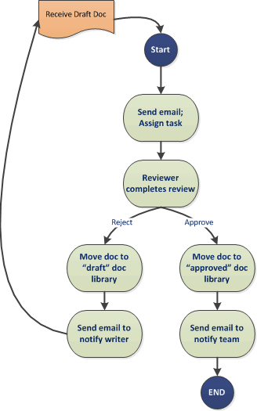
What are workflows?
Workflows allow you to model and automate business processes
Ideal for
Long running processes
Processes that don’t require immediate handling (i.e. input validation)
Processes that require user input
Processes that require reliable messaging
Setting up processes without requiring a developer
Notes:
Workflows allow you to model and automate business processes.
These can be as simple as a document approval process with a single approver and as complex as virtually any structured business process you can imagine full of conditions, loops, user inputs, tasks, custom actions, web service calls and database support.
Once these processes have been defined and turned into workflows, you can attach them to SharePoint lists and sites so that when a document or list item is created or edited, the workflow will process the new item in some way.
If you are looking to learn more about the subject, you should start here: http://msdn.microsoft.com/en-us/library/jj163917.aspx

Slide 7
History on workflows in SharePoint
Microsoft Office SharePoint Server 2007 & SharePoint 2010
Workflows executed inside w3wp.exe or owstimer.exe
Potential for scalability problems
Not suited for shared hosting environments
SharePoint 2013/2016/2019/Online
Workflows are stored and executed in a separate process outside of SharePoint
Utilizing Workflow Manager which is a generic product with an own product group
Allows for separate scaling of workflow usage
SharePoint 2010 in process workflow engine still available for backward compatibility
InfoPath no longer supported for Initiation Forms
Workflow Foundation 3.0
Workflow Foundation 4.0
Notes:
Looking back on how workflows evolved with the last SharePoint versions, we see that in MOSS 2007 and SharePoint 2010, workflows ran inside the SharePoint process. Which meant that when a workflow would manually be triggered by an user, it would run inside the same IIS worker (w3wp.exe) process that is serving SharePoint to the end user. If the workflow would be started automatically, i.e. when creating a list item, it would run in the SharePoint TimerJob service (owstimer.exe). This didn’t make it very scalable as adding capacity for workflows meant you had to add a complete SharePoint server to your SharePoint farm.
In SharePoint 2013 Workflows are no longer running inside SharePoint processes, just like we see with anything else that can be customized. Instead its now running in a separate product called Workflow Manager. This is a generic, non SharePoint specific product owned by its own Product Group and having its own architecture separate from SharePoint. So no longer are the workflows limited by the progress of the SharePoint Product Group, which is a good thing. On the next slides we’ll dive a bit deeper into Workflow Manager.
For backward compatibility, SharePoint 2013 still has the SharePoint 2010 in process workflow service available. So this still has all the downsides as it had before and should not be used for new workflows anymore.
SharePoint 2010 was still using Workflow Foundation 3.0, whereas SharePoint 2013, or better said, Workflow Manager, is based on Workflow Foundation 4.0.
Initiation Forms (forms that are shown to the user when a workflow starts to ask for extra input) are no longer supported to be done in InfoPath in SharePoint 2013. Instead you can create your own pages in an Add-In from which you initiate and pass additional parameters on to the workflow.

Slide 8
Workflow Manager
Dedicated service that runs workflows on behalf of other applications
Requires either 1 or 3 servers running Workflow Manager
Ideally on dedicated server(s), can be installed along with other products (i.e. on SharePoint App servers)
Uses Service Bus for Windows Server
A “message broker” that receives workflow requests from SharePoint and forms them into a queue
Workflow Manager picks a request from the queue and processes it
Uses the same OAuth and REST technology as we do for Add-Ins to communicate with SharePoint
Notes:
Workflow Manager is the product that is responsible for the execution of workflows. It’s a dedicated Windows Service that hosts a self hosted HTTP(S) service through which it interacts with external services like SharePoint. Important to realize is that Workflow Manager is not only or specifically for SharePoint. Basically it can run workflows from any kind of application.
It requires either one or three servers, no other amount is supported. This is by design of Workflow Manager. You choose one server if workflows aren’t business critical and downtime can be afforded, you choose three servers if it is business critical and other servers need to be able to take over workflow execution if one of the three fails (or i.e. gets updated and needs a reboot). The Workflow Manager service can be installed along with other products. Ideally it will be running on its own (virtual) servers, but it is also common to install it on SharePoint App\Backend servers. The best scenario depends on how intensively SharePoint and workflows are being used and the hardware underneath.
Workflow Manager makes use of another Microsoft product called Service Bus. Look at it like a message broker/queue like MSMQ. It receives requests which contain instructions for Workflow Manager about the workflow it needs to run. Workflow Manager connects to the Service Bus and polls it for new messages and will handle them on a First In First Out (FIFO) base. The queued items are stored in a SQL Server database so that all instances of Service Bus can use them and they’re persistent and will survive sudden server crashes.
Also nice is to realize that when a workflow running in Workflow Manager interacts with SharePoint, i.e. when its creating a task, it is leveraging the same OAuth security and REST endpoints as we use in our own Add-Ins. So it’s really becoming one generic standard that is used throughout SharePoint which makes things easier to understand and troubleshoot.

Slide 9
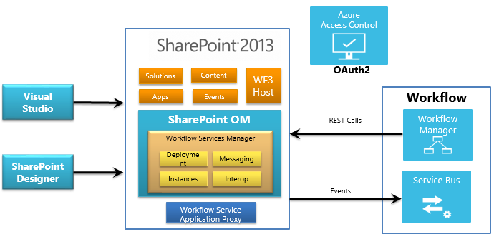
Architecture
SharePoint
Notes:
This overview diagram shows the different components which are used in creating, managing and running SharePoint 2013 workflows. Like previous versions of the product, workflows can be created in Visual Studio and SharePoint Designer, however unlike previous versions these no longer run on the SharePoint server, but are sent to an external system for processing which then makes calls back into SharePoint when it requires more information.
SharePoint Designer 2013 is the primary business-user tool for creating workflow definitions and publishing them, as was the case in previous versions. It can also be used to package a workflow definition with or without associated SharePoint components. SharePoint Designer can create and deploy both SharePoint 2010 and SharePoint 2013 workflows.
Visual Studio not only provides a designer surface for creating declarative workflows, but it can also create Add-Ins for SharePoint, custom activities for SharePoint Designer and solutions that fully integrate Workflow Manager functionality.
In previous SharePoint versions workflow execution was hosted in SharePoint itself, therefore there is also an implementation of the SharePoint 2010 workflow host (that is, the Windows Workflow Foundation 3 engine) for backward compatibility.
Workflow Manager is the new external system which processes workflow requests. It provides the management of workflow definitions and hosts the execution processes for workflow instances. Workflow Manager is external to SharePoint and communicates using common protocols over the Windows Service Bus, mediated by OAuth2. SharePoint events for which a workflow is listening, e.g. itemCreated, itemUpdated, are routed to the Workflow Server using the Windows Service Bus. For the return trip to gather more information or return results, the platform uses the SharePoint REST API to call back into SharePoint.

Slide 10
SharePoint 2013 Workflows
Custom code is no longer possible
Goes for both SharePoint Designer as well as Visual Studio
Call HTTP Web Service action is available to call a webservice which can run custom logic and optionally return data
Steps involved in a workflow are described in XAML
Automatically generated by SharePoint Designer and Visual Studio
Can be deployed as part of a SharePoint Add-In
Use them as the middle tier business logic for applications
Add-Ins for Office
Add-Ins for SharePoint
Notes:
Zooming in on the new SharePoint 2013 Workflows we see a few interesting aspects. First of all, no custom code can be used anymore inside workflows. This means what you can do is limited to the predefined actions registered in Workflow Manager. This limitation is valid for both SharePoint Designer 2013 as well as Visual Studio 2013. There is however a new action called “HTTP Callout” which allows you to call out to a custom webservice where custom logic can execute and optionally even pass back information for the workflow to process. More on this later in this course.
When creating a workflow, behind it there’s XAML which declaratively defined what will be done when the workflow runs.
SharePoint 2013 Workflows can also be added to an Add-In. So it becomes available when an Add-In is installed. It is a good way to hide business logic. I.e. when creating a SharePoint Hosted Add-In, anybody could open up the sources in JavaScript and discover what you’re doing. If you move the logic to a workflow and the JavaScript just kicks off the workflow or creates a list item which triggers a workflow, the end user is not able to see what happens inside the workflow.

Slide 11
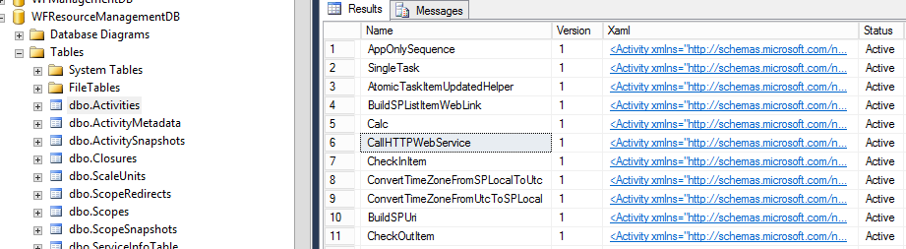
How SharePoint specific actions get registered
When connecting a SharePoint Farm to a Workflow Manager Farm (WFM), SharePoint sends:
Its supported activities
Microsoft.SharePoint.WorkflowServices.dll containing the implementation of the activities
Registration is stored in the WFM database WFResourceManagementDB in the Activities table
SharePoint Updates may update the activities and/or the implementation
Notes:
Since Workflow Manager is a generic non SharePoint specific product to run workflows, it begs the question, how does Workflow Manager know about the SharePoint specific actions like creating a task or updating a list item? The answer lies in what happens when connecting a SharePoint Farm with Workflow Manager. This requires a one time execution of PowerShell commands to let SharePoint 2013 know which Workflow Manager farm to use to execute SharePoint 2013 Workflows. When this registration takes place, SharePoint signals Workflow Manager about the activities that it supports and provides Workflow Manager with a DLL named Microsoft.SharePoint.WorkflowServices.dll which contains the implementation of these actions. This information gets stored in the WFResourceManagementDB database belonging to Workflow Manager, more specifically in the Activities table.
When patching SharePoint using i.e. a Cumulative Update, it may contain updates to workflow activities and/or the implementation behind them as well. In this case, when running the SharePoint Configuration Wizard (psconfig), as part of the upgrade process, it will also call out to Workflow Manager to inform it about the updates.

Slide 12
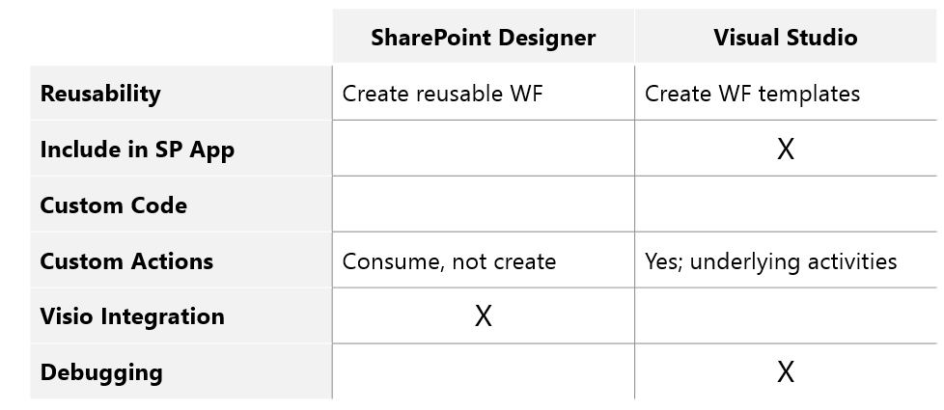
Tools
SharePoint Designer 2013
Visual Studio 2012, 2013, 2015, 2017 or 2019
Notes:
For creating SharePoint 2013 Workflows we can use SharePoint Designer 2013 or Visual Studio 2012 or later The table on this slide shows the differences between these two options.
Since SharePoint Designer cannot be used to create any kind of SharePoint Add-Ins, this also means it doesn’t allow for a workflow to be created that will be packaged inside an Add-In. Only Visual Studio allows for doing this.
As mentioned before, both tools do not offer the execution of custom code in workflows.
SharePoint Designer does not allow the creation of custom actions, it only asks Workflow Manager to provide it with the activities that it supports and offers those to the user. Visual Studio does allow for underlying activities to be created. Doing this is out of scope for this training.
Visio integration will be explained later in this course, for now notice that only SharePoint Designer leverages this option.
If you want to debug workflows, Visual Studio allows for stepping through it to debug it. SharePoint designer doesn’t offer this option. More on this later in this course as well.

Slide 13
SharePoint Designer 2013
Improved visual designer
Integrated the Visio designer into SharePoint Designer
Can switch between visual designer & sentence-style
Editable properties helper
Designer supports cut / copy / paste / undo / redo / select-all
Improved email editor (rich formatting)
Step and loop options have been added
Notes:
The experience of creating workflows in SharePoint Designer has changed little from the previous versions however there have been a number of new features introduced which improve the process.
In addition to the existing Text-Based Designer, SharePoint Designer has been improved to include a visual designer for authoring and customizing workflows, similar to how Visio allowed you to create workflows in previous versions of SharePoint. This offered integration with Microsoft Visio 2010, so that you could design workflows visually in Visio and then import them into SharePoint Designer. Now, you can visually design your workflows by dragging, dropping, and connecting shapes directly within SharePoint Designer 2013. You can set all the properties of a workflow action in the new visual workflow designer—just select the shape and then click the action tag. Also, if you click Properties on the action tag, the property grids for conditions and actions appear in the visual designer, just as they do in the declarative workflow designer.
This new designer is available when Visio is installed, allows you to not only customize the workflow actions & stages but you can modify the properties of the actions directly in the Visual Designer.
Also new in SharePoint Designer 2013 is the availability of Step and Loop options in the ribbon. Steps are used to combine logic so they are visually grouped and can carry a title in SharePoint Designer 2013. Loops can be used to loop through the actions inside the loop for a specified number of times or to keep looping the actions until some condition you define becomes true.

Slide 14
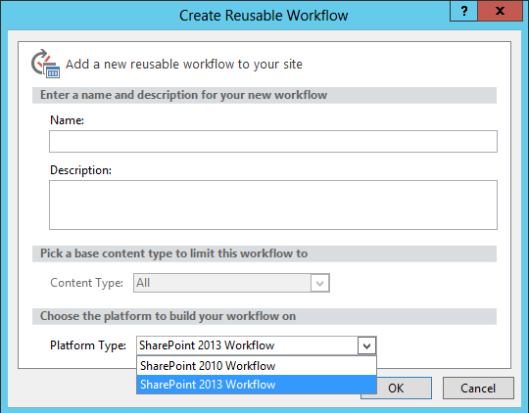
SharePoint Designer 2013
Selection box allows for selection between
SharePoint 2010 Workflow
SharePoint 2013 Workflow
If SharePoint 2013 Workflow not shown, Workflow Manager is not properly configured on the SharePoint Farm
Notes:
When creating a new workflow in SharePoint Designer 2013, you’ll see a dropdown list in which you can select if you want to create a SharePoint 2010 or a SharePoint 2013 Workflow. If the SharePoint 2013 Workflow option is not shown or the dropdown is greyed out, it means that the SharePoint 2013 Farm you’re connected to using SharePoint Designer 2013 is not (properly) configured for using a Workflow Manager server or farm.

Slide 15
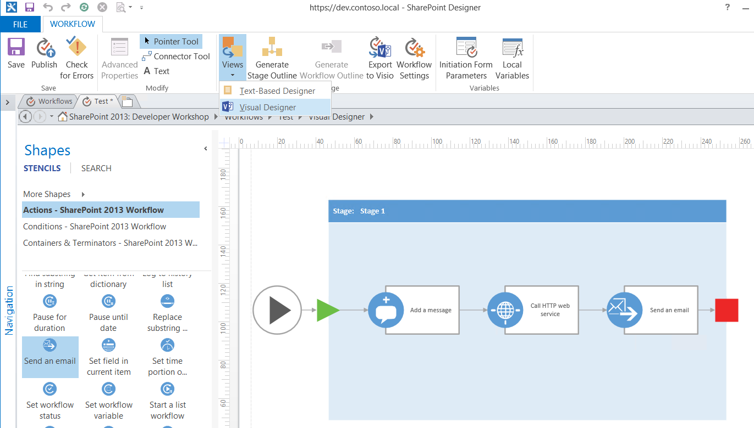
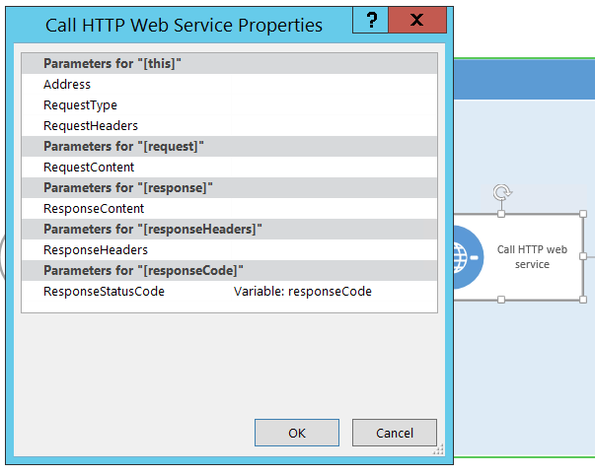

SharePoint Designer 2013
Requires having Visio 2013 installed on the same machine as SharePoint Designer 2013
Notes:
The experience of creating workflows in SharePoint Designer has changed little from the previous versions however there have been a number of new features introduced which improve the process.
In addition to the existing Text-Based Designer, SharePoint Designer has been improved to include a visual designer for authoring and customizing workflows, similar to how Visio allowed you to create workflows in previous versions of SharePoint. This offered integration with Microsoft Visio, so that you could design workflows visually in Visio and then import them into SharePoint Designer. Now, you can visually design your workflows by dragging, dropping, and connecting shapes directly within SharePoint Designer 2013. You can set all the properties of a workflow action in the new visual workflow designer—just select the shape and then click the action tag. Also, if you click Properties on the action tag, the property grids for conditions and actions appear in the visual designer, just as they do in the declarative workflow designer.
This new designer is available when Visio is installed, allows you to not only customize the workflow actions & stages but you can modify the properties of the actions directly in the Visual Designer.

Slide 16
Creating a workflow in SharePoint Designer 2013
Notes:
Show how you can use SharePoint Designer 2013 to create a workflow.

Slide 17
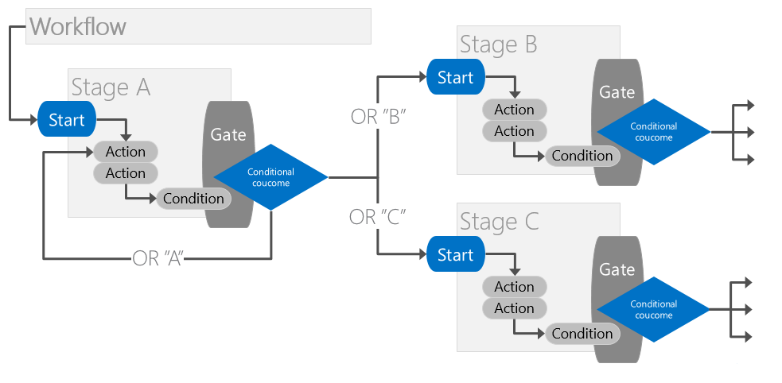
Workflow Stages
Provides support for repeating & skipping workflow steps
Each stage has an entry point & gate
Gate: conditional transition point where workflow stage exits
Can contain multiple steps
Mitigates SharePoint Designer loop limitations
Notes:
In the past, declarative workflows have been strictly serial: They start at the beginning and progress to the end and it was not possible loop back based on some condition.
Stages: Now, SharePoint Designer 2013 introduces an important new building block—the stage (technically this feature was introduced in the WF 4.0 platform). Stages are a top-level container that you use to group together a number of individual actions and conditions as a single unit to more clearly define the process.
For example, a workflow could consist of two stages. Within the first stage would be all of the actions that are necessary to approve a document. Once this has been completed, the workflow moves onto the next stage. If however this second stage decides that the document needs to be re-Approved, it can loop the workflow back to the beginning of stage 1.
Each stage can contain actions and conditions, or steps which themselves contain actions or conditions. Just as in previous versions, steps are serial in nature and do not include support for looping or conditional jumping – that’s the domain of Stages.
In Summary: The conditions, actions, or steps in one stage are processed in the listed order before the workflow transitions to the next specified stage. But here’s the important part: The transition means that the next stage can be any stage in the workflow—not necessarily the next stage serially.
As a result you can build state machine like workflows which transition from one state to another.
Stages have the following rules and limitations:
Stages, not steps, are the new top-level containers.
Stages cannot be nested in any other building block; a stage must be at the top level.
Only stages can have Go To actions, and the target of a Go To action must be another stage.
Steps can be nested in stages and other steps.
A stage can be connected only to another stage. (In the visual workflow designer only, a stage can also be connected to a condition shape.)
There can be only one path into a stage and one path out. All actions in the workflow must be contained by a stage. Stage shapes are visualized by using container shapes.
All diagrams must have at least one stage.
Stages cannot have any connectors coming in or going out other than through the Enter and Exit shapes.
Stage containers cannot be nested. If you want to nest another sub-process within a stage, use a step.
Stop Workflow shapes may exist within a stage.
An explicit Start shape is required outside of the stage for the entire diagram. An explicit Terminate shape outside of the stage is not required.
At the top level, the workflow can contain only stages, conditional shapes, and Start and Terminate terminators. All other shapes must be contained within a stage
Loops: A loop is a container that you can use to group conditions and actions that you want the workflow to process repeatedly. These are a series of connected shapes that will execute as a loop, returning from the last shape in the series to the first, until a condition is satisfied.
Like stages, loops are represented by a container shape that includes an Enter and Exit shape (added when the shape is dropped on the drawing canvas). A Loop shape also requires that an Enter and Exit shape be added to the edges of the container to define the paths in and out of the loop.
Visio 2013 and SharePoint Designer 2013 support two types of loops: loop n times and loop until value1 equals value2.
Loops must also conform to the following rules:
Loops must be within a stage, and stages cannot be within a loop.
Steps may be within a loop.
Loops may have only one entry and one exit point.
Stages which are founded on the flowchart workflow type in WF 4.0, mitigate a lot of the challenges people had creating workflows with SharePoint Designer in previous versions of SharePoint, specifically the loop limitations

Slide 18
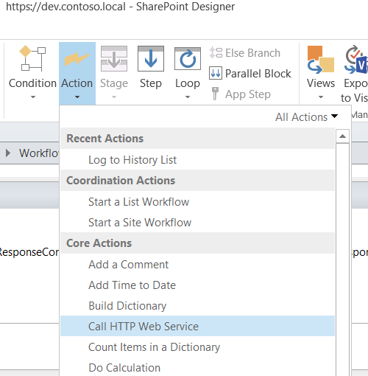
Calling web services
Call HTTP Web Service action allows calling out to a web service
Available in SharePoint Designer 2013 and Visual Studio
Can call to REST / WCF / SOAP web services
Can perfectly be hosted in Provider Hosted Add-Ins
Allows custom code to run as part of a workflow
Notes:
Owing to the limitations of previous versions of SharePoint Designer, it was difficult to make a call from a workflow to an external system unless you routed your requests via SharePoint lists or developed custom components.
Developers were forced to either build custom activities and wrap them in actions for use in SharePoint Designer workflows (or build the workflow wholly in Visual Studio) when they needed to work directly with the SharePoint API, connect & query custom databases, consume RSS/ATOM/REST feeds or interact with Web services.
Furthermore, none of these things were possible in a hosted environment as they could only be done from fully-trusted farm solutions.
SharePoint 2013 introduces a new action called the Call HTTP Web Service action which makes it very easy to call external HTTP services (websites & web services etc.) to send and receive data.
Providing you can expose your data source as an OData feed / SOAP or WCF web service the HTTP GET action will be able to talk with it and exchange data.
Data returned by those Web services is stored in workflow variables and can then be used by the workflow in any number of scenarios. These actions provide great flexibility in integrating data external to SharePoint into your workflows.
As the authoring tools in SharePoint 2013 including both SharePoint Designer & Visual Studio support building declarative workflows only, the recommended approach to custom logic/code is to create a custom SOAP / REST service and use the new service actions to call out to the service.

Slide 19
Rights Elevation through App Step
By default SharePoint 2013 workflows run under the User + App context
This means that if the users cannot perform the action the workflow will not be able to perform the action either
App Steps allows elevation to an App only context
Per site collection there is only one App context for SharePoint 2013 Workflows
By default the App Only context has Write permissions to the Web
Workflow can now do things the user can’t do
I.e. adding a list item
Notes:
SharePoint 2013 Workflows utilize the same Add-In and OAuth principles as we can use in our Add-Ins. By default when a SharePoint 2013 Workflow gets triggered, it will execute under the User + App Context. This means that if you i.e. try to add a list item in a workflow, the user must have rights to do so as well. If you don’t want this and want to elevate above the permissions that the user has, you can use an option called App Step. This brings an App only OAuth context into play when executing the workflow. By assigning rights to the OAuth trust, the workflow can do whatever rights you assign to it, even if the user executing the workflow doesn’t have those rights.
For more information, see https://docs.microsoft.com/en-us/sharepoint/dev/general-development/create-a-workflow-with-elevated-permissions-by-using-the-sharepoint-workflo

Slide 20
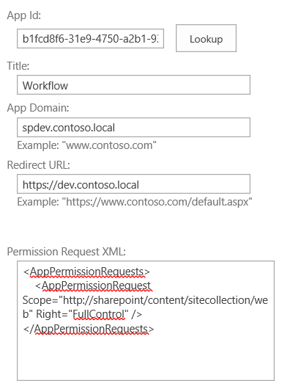
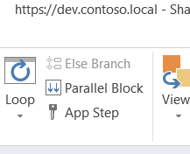
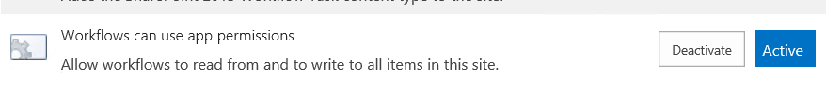
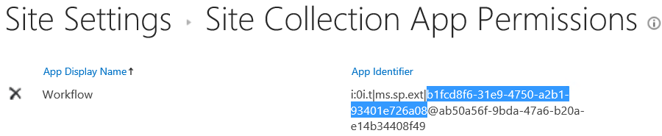
Rights Elevation through App Step
Activate site scoped feature “Workflows can use app permissions” on site where to use the Workflow with an App Step
Update the default Write permissions on the Web (optional)
Look up the Add-In Identifier created for the workflows on appprincipals.aspx
Assign rights to the Add-In Identifier using appinv.aspx
AppStep becomes available in SharePoint Designer
4
3
1
2
Notes:
In order to start using App Steps in SharePoint 2013 Workflows, you need to go through the following four steps:
1.
Go into the site settings of the site on which you want to run a workflow that will utilize the App Step functionality. Click on Manage Site Features. At the bottom you should find a feature named “Workflows can use app permissions”. Activate this feature.
2a.
Go to the page /_layouts/15/appprincipals.aspx in your site collection. You should find an entry with the App Display name “Workflow”. Copy the part between the ms.sp.ext| and the @ sign as shown on this slide. This part is the App ID / Client ID that has been set up by the feature to be used by workflows.
2b.
Change the url in the browser to go to /_layouts/15/appinv.aspx on the site collection where you will use the workflow. In the App Id box, paste the guid retrieved from the previous step and click on Lookup. It should now find some of the details of the Add-In. In the “Permission Request XML” you can now paste the XML which defines the rights that the elevated workflow should have. You can best use Visual Studio to create this XML. Open Visual Studio, create a new SharePoint Hosted Add-In, open up the App Manifest, set the rights you wish to assign to the workflow, save your project, right click on the AppManifest.xml in the Solution Explorer and click on View Code. You’ll now see the XML behind the AppManifest. In it you should see a section called AppPermissionRequests. Copy only this section and paste it into the Permission Request XML field on the appinv.aspx page. I.e. to assign the workflows full control to the site collection, use the following XML snippet: <AppPermissionRequests> <AppPermissionRequest Scope="http://sharepoint/content/sitecollection/web" Right="FullControl" /> </AppPermissionRequests>
2c.
Now start SharePoint Designer 2013. If you already had it open, close it and reopen it so it will pull fresh information from SharePoint and will now know that the AppStep should become available. When editing a SharePoint 2013 Workflow, in the ribbon you should now have the App Step option which you can use. Only the actions you put into the App Step will be elevated. All other actions outside of it will remain to run under the User + App context.

Slide 21
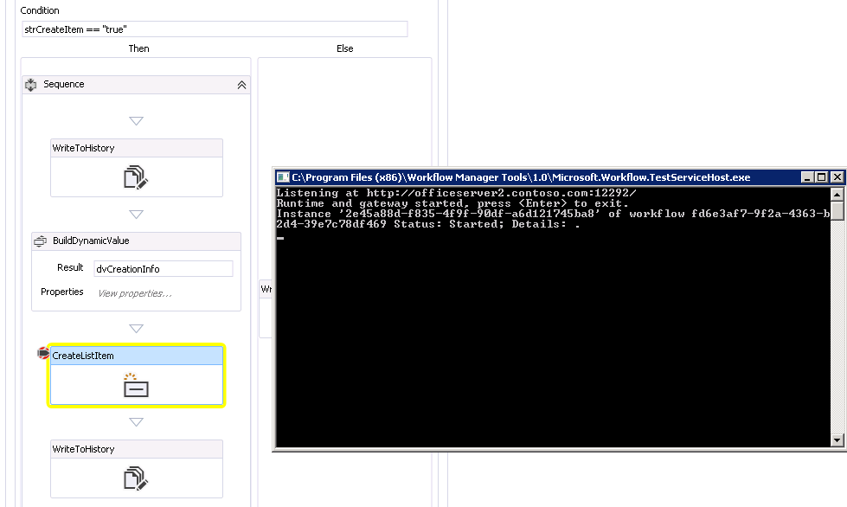
Debugging workflows
Set breakpoints & step through design
Spawns Workflow Manager process
Only in Visual Studio
In SharePoint Designer use Log to History List
Log at most 255 characters in one message
Notes:
If you want to debug your workflow, in Visual Studio you can easily run the workflow and step through it. This works by Visual Studio spawning a Workflow Manager process on the background through which it can step. For SharePoint Designer, your best option is to use the “Log to History List” action so you can keep track of the flow of a workflow. Be sure to remove them again though when you bring your workflow to production as making heavy use of history list logging might make the the history list tied to the workflow explode and cause side effects in SharePoint if not properly managed.
There’s a bug in SharePoint 2013 Workflows in regard to using the Log to History List action. If you try to log a message longer than 255 characters, the workflow will crash and fail to execute. Make sure you don’t log anything that consists of more than 255 characters.

Slide 22
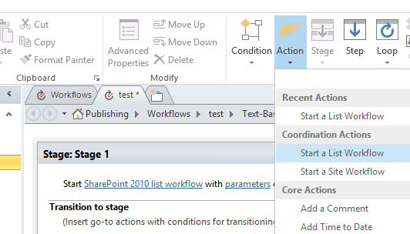
2010 to 2013 workflow
Call SharePoint 2010 workflow from SharePoint 2013 workflow
Utilize investments done in SharePoint 2010 workflows
SharePoint Designer 2013 has two actions for this:
Start a List Workflow
Start a Site Workflow
Notes:
When a company has invested a lot of time and money in SharePoint 2010 workflows already, it might not easily switch to SharePoint 2013 workflows. To aid in the transition, two new actions have been introduced which allow a SharePoint 2010 workflow to run as part of a SharePoint 2013 workflow. When a workflow needs maintenance or expansion, with the use of these two actions the new functionality can then be built in a SharePoint 2013 workflow while still leveraging what is already in place in the SharePoint 2010 workflow.

Slide 23
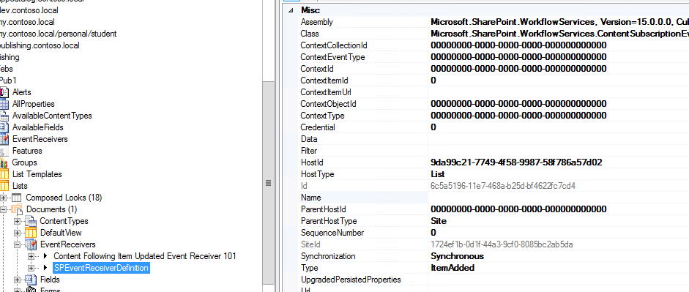
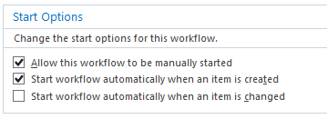
How SharePoint 2013 Workflows get triggered
Event receiver is registered which signals the Workflow engine to start the workflow in WFM
Only when the workflow is set to automatically start
SharePoint Manager allows insight in how this works
Notes:
The way workflows get initiated technically is by SharePoint registering an event receiver on the item to which a workflow is applied (i.e. list/web). It calls code in the Microsoft.SharePoint.WorkflowServices assembly witch on its turn takes care of the reliable messaging. For this reason it has not been designed to use a Remote Event Receiver which would trigger the REST endpoint of the Workflow Farm directly as this would not allow for reliable messaging.
With a tool such as SharePoint Manager which is available on the workshop lab machines in the Tools folder on the desktop, you can see the event receivers on the lists.

Slide 24

Reliable messaging
SharePoint 2013 Workflows Infrastructure is by default not 100% reliable
Meaning Workflow Manager down, workflows will never get triggered, no retries
Same behavior as Remote Event Receivers in SharePoint 2013
SharePoint 2013 Workflows can be made reliable
Add MSMQ Windows Feature to all of the SharePoint servers in your farm
In PowerShell: Add-WindowsFeature -Name MSMQ-Services
Set WorkfowServiceAplicationProxy to allow queueing using PowerShell
When the Workflow Farm is down, messages will be persisted and retried later
Notes:
By default, SharePoint 2013 Workflows are not reliable. This means that if the Workflow Manager farm would be down or not available, an attempt to run a workflow (i.e. based on an automated start) would fail and not retry. This is the same behavior as for Remote Event Receivers in SharePoint 2013. There is a way however to make SharePoint 2013 Workflows reliable. This can be done by simply adding the MSMQ Windows Feature to all SharePoint 2013 servers in your farm. This can be accomplished using PowerShell by running “Add-WindowsFeature -Name MSMQ-Services”. No reboot is required. After MSMQ has been added to the SharePoint 2013 Server, the first time a workflow gets triggered, a new messagequeue will automatically be created named “microsoft.workflow.client.publishednotifications”. Requests for starting workflows will be stored in this MSMQ and a process will frequently poll this queue and attempt to deliver the request to Service Bus after which Workflow Manager can pick it up to process the message. In the case where Service Bus would not be available, it will keep retrying the operation indefinitely until it succeeds.
For more information, see: https://docs.microsoft.com/en-us/sharepoint/dev/general-development/how-to-configure-msmq-for-sharepoint-workflows

Slide 25
Exporting Workflows from SharePoint Designer
Possible to export Workflows from SharePoint Designer
Handy i.e. when moving between staging environments
Steps to take:
If a list workflow, make the list available in the target site
Export the Workflow
Copy the WSP from the Assets library to the target site
Import the WSP as a sandboxed solution and activate it
Activate the feature with the workflow in it
Reconfigure the workflow using SharePoint Designer
Notes:
It is possible to move workflows created in SharePoint Designer 2013 to a different environment. This slide shows the steps that you need to go through to accomplish this. The next slides will go into detail on each of these steps.

Slide 26
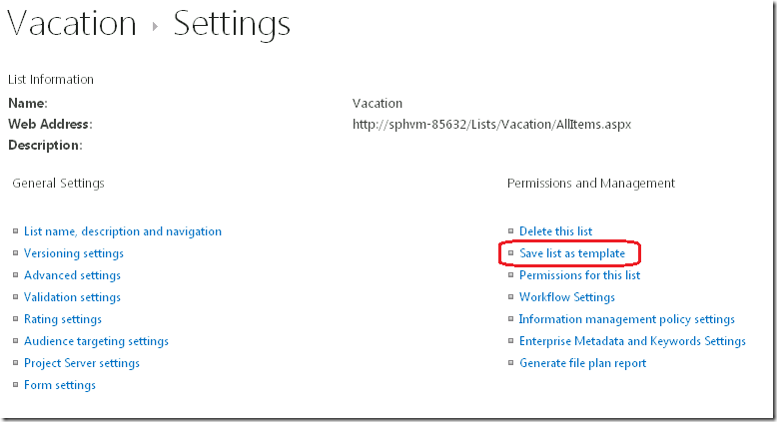
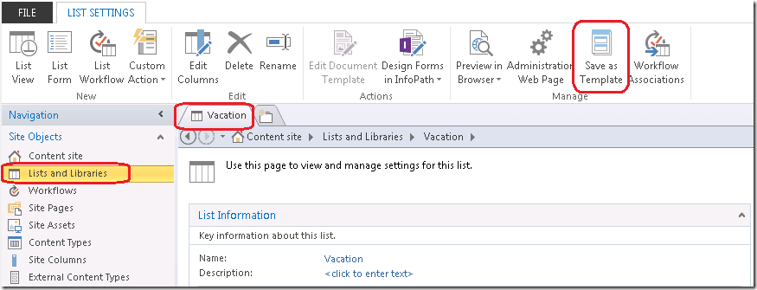
Exporting Workflows from SharePoint Designer
Step 1
If a list workflow, make the list available in the target site
Save list as template via List Settings on web interface
Save as Template from SharePoint Designer
Import STP into List Templates of target site
Create new instance

Slide 27
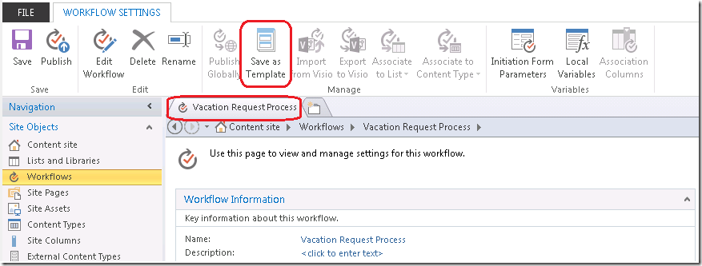
Exporting Workflows from SharePoint Designer
Step 2
Export the Workflow
Go to the workflow in SharePoint Designer
Click on Save as Template in the ribbon

Slide 28
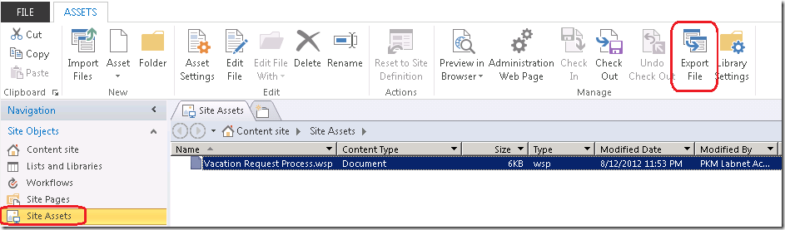
Exporting Workflows from SharePoint Designer
Step 3
Copy the WSP from the Assets library to the target site
Go to the Site Assets library
Select the exported workflow
Click on Export File in the ribbon
Copy the WSP file to the target environment

Slide 29
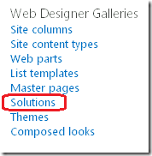
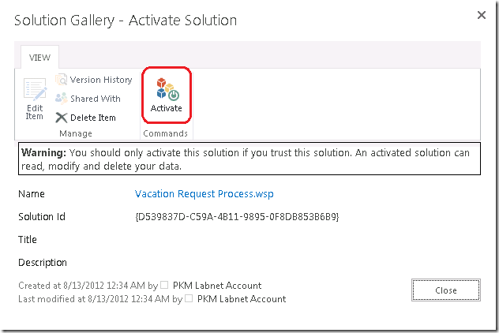
Exporting Workflows from SharePoint Designer
Step 4
Import the WSP as a sandboxed solution and activate it
Go to Site Settings -> Solutions
Upload the WSP file
Click on Activate

Slide 30
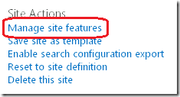
Exporting Workflows from SharePoint Designer
Step 5
Activate the feature with the workflow in it
Go to Site Settings -> Manage site features
Activate the feature named “Workflow template ‘<workflow title>’ from web template ‘template name’”

Slide 31
Exporting Workflows from SharePoint Designer
Step 6
(Optional) reconfigure the workflow using SharePoint Designer
You can now open the workflow in the target location using SharePoint Designer and verify if all is OK

Slide 32
Knowledge Check
Where are SharePoint 2013 Workflows being executed?
Can we use SharePoint Designer 2013 to create workflows that go through staging environments?
No, custom code is no longer allowed inside SharePoint 2013 Workflows
Can SharePoint 2013 Workflows run custom code?
In a separate product called Workflow Manager running outside of SharePoint
Yes, SharePoint Designer 2013 allows us to design a workflow on i.e. a development environment and then export it so it can be used on other staging environments

Slide 33
Lesson Summary
SharePoint 2013 Workflows use a different topology as opposed to SharePoint 2010 Workflows
New functionality has been introduced like HTTP Web Service calls, stages, loops
Workflows now run in a separate product outside of SharePoint called Workflow Manager

Slide 34
Questions?

Slide 35
Lab: Workflows
In this lab you are going to create a workflow using SharePoint Designer 2013 and another one using Visual Studio 2017
Time estimation: 45 minutes
Notes:
Lab content can be found under “Lab – Workflows”

